Slide 1
Halting Functions for Tree-Like Structures
CS 5010 Program Design Paradigms “Bootcamp”
Lesson 6.6
© Mitchell Wand, 2016
This work is licensed under a Creative Commons Attribution-NonCommercial 4.0 International License.

Slide 2
Learning Outcomes
At the end of this lesson, the student should be able to
Explain the definition of a halting measure for mutually-recursive functions
Write a halting measure for functions on S-expressions that use the template.

Slide 3
Let's review halting measures for list functions
Let's look at the template for list data and the definition of a halting measure.
Then we'll look at the call graph for a list function and see what the halting measure looks like on the call graph.

Slide 4
Review: Template for List data
;; list-fn : ListOfX -> ??
(define (list-fn lst)
(cond
[(empty? lst) ...]
[else (... (first lst)
(list-fn (rest lst)))]))
Remember the template for list data

Slide 5
Review: Halting Measure
Definition: a halting measure for a particular function is an integer-valued quantity that can't be less than zero, and which decreases at each recursive call in that function.

Slide 6
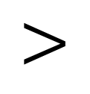
Another picture: the call graph
list-fn calls itself. The halting measure (the size of the argument) decreases at each call.
list-fn
$$<$$
A computation can go around this cycle only finitely many times, because the halting measure is always a non-negative integer.
halting measure decreases

Slide 7
Now let's do it again for SoS and LoSS
An S-expression of Strings (SoS) is either
-- a String
-- a List of SoS's (LoSS)
A List of SoS's (LoSS) is either
-- empty
-- (cons SoS LoSS)
Here's the data definition again

Slide 8
This is mutual recursion
SoS LoSS
defined in terms of
defined in terms of

Slide 9
And here's the template
;; sos-fn : SoS -> ??
(define (sos-fn s)
(cond
[(string? s) ...]
[else (loss-fn s)]))
;; loss-fn : LoSS -> ??
(define (loss-fn los)
(cond
[(empty? los) ...]
[else (... (sos-fn (first los))
(loss-fn (rest los)))]))

Slide 10
This is mutual recursion
sos-fn loss-fn
defined in terms of
defined in terms of

Slide 11
What's a good halting measure for this pair of functions?
We claim that the size of the SoS or LoSS is a halting measure for this pair of functions.
What do we mean by size here? Ans: the number of cons cells
But wait, you say: when sos-fn calls loss-fn, this size of the argument doesn't decrease
Let's look at this more closely by examining the call graph

Slide 12
Let's draw the call graph in more detail
sos-fn calls loss-fn
sos-fn and loss-fn may call other functions, but none of those functions ever call sos-fn or loss-fn
sos-fn
loss-fn
loss-fn calls sos-fn and loss-fn

Slide 13
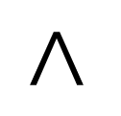
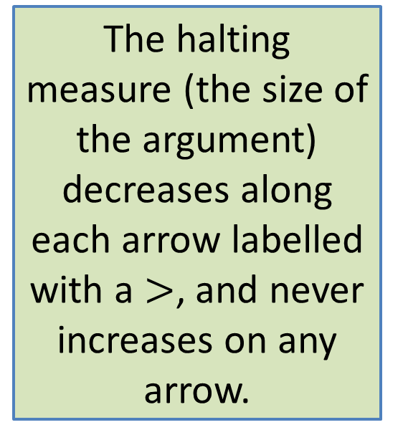

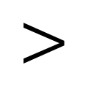
Where does the halting measure decrease?
So the halting measure decreases around every cycle in this graph. Since the size of the argument is a non-negative integer, a computation can make only finitely many calls in this graph.
The halting measure (the size of the argument) decreases along each arrow labelled with a $>$, and never increases on any arrow.
sos-fn
$$=$$
$$<$$
loss-fn
$$<$$

Slide 14
Refined Definition of a Halting Measure
Definition: a halting measure for a particular function is an integer-valued quantity that can't be less than zero, and which decreases around every cycle in the call graph.
In general, you can't just look at a single function– you have to trace the call graph.
For functions that follow the template, the size of the argument is almost always a halting measure.

Slide 15
A more subtle example Descendant Trees
(define-struct person (name children))
;; A Person is a
;; (make-person String Persons)
;; A Persons is one of
;; -- empty
;; -- (cons Person Persons)
Two mutually recursive data definitions

Slide 16
What's a good way to measure the size of one of these?
Ans: number of nodes in the tree, where a node is either a make-person or a cons.
This is the standard way of measuring the size of a structure.

Slide 17
Example of a pair of functions on this data definition
;; Person -> Persons
;; STRATEGY: Use template for Person on p
(define (person-descendants p)
(append
(person-children p)
(persons-descendants (person-children p))))
;; Persons -> Persons
;; STRATEGY: Use HOF map followed by foldr
(define (persons-descendants ps)
(foldr append empty
(map person-descendants ps)))
With HOFs, the finding the call graph may take more care. Here's an example.

Slide 18
The call graph for this pair of functions
person-descendants
via map
persons-descendants

Slide 19

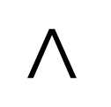
The halting measure decreases on both arrows
person-descendants
(person-children p) is
smaller than p
$$<$$
$$<$$
persons-descendants
All we need is for the halting measure to decrease on every cycle, so it would be ok if one of these >'s was an =. Just so long as none of the calls increases the halting measure!
map calls person-descendants on
each element of ps; the elements of ps
are always smaller than ps

Slide 20
Summary
You should now be able to:
Explain the definition of a halting measure for mutually-recursive functions
Write a halting measure for functions on S-expressions and other mutually-recursive data types that use the template.

Slide 21
Next Steps
If you have questions about this lesson, ask them in class or on the Discussion Board
Go on to the next lesson

